Slide 1

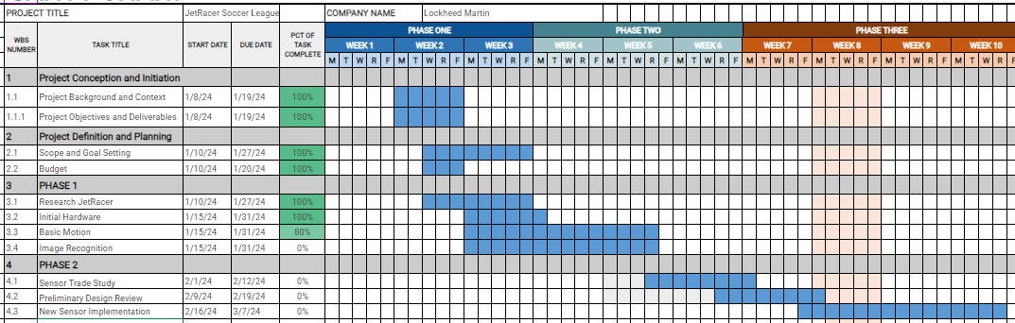
Overview
JetRacer Soccer Jarod Marshel, Casey Rittenhouse, Arjun Simha, Mason Kang, K Gupta, Julie Ham, Cooper Ritter
Overall Concept:
Overall Project Deliverable | Progress
Basic Movement | In progress
Image recognition | In progress
New sensor implementation | Not started
Ball Striking | Not started
Co-op and Versus | Not started
Github with documentation | Not started
Summary and report | Not started
Project is On Schedule
Gantt Chart/Schedule

Slide 2
Short-Term
JetRacer Soccer Jarod Marshel, Casey Rittenhouse, Arjun Simha, Mason Kang, K Gupta, Julie Ham, Cooper Ritter
Previous Meeting Action Items:
Item | Description | Owner | Target Date | Status
1 | Get familiar with car and previous years' work | Everyone | Jan 22 | In progress
2 | Move to Sharepoint | Arjun | Jan 19 | Done
3 | Kanban & Gantt Chart | Julie | Jan 22 | Done
4 | Car CAD Models | Cooper | Feb 12 | In progress
5 | Fill out inventory form – initial inventory | Jarod, Arjun, Casey, Julie | Jan 22 | Done
6 | Reach out to stakeholders and establish weekly meetings | Arjun | Jan 19 | Done
7 | Unity soccer simulation training | Casey | Jan 31 | In progress
Biweekly Action Items:
Item | Description | Owner | Target Date | Status
1 | Get all cars working with manual movement | Everyone | Feb 9 | In progress
2 | Move at least 1 car autonomously | Everyone | Jan 31 | In progress
3 | Redo hardware attachment to cars | Everyone | Feb 12 | In progress
4 | Demonstrate image processing | Everyone | Jan 31 | In progress
5 | Start working on Unity AI model to play soccer | Everyone | Jan 31 | Not started
Significant Roadblocks/ Non-developing Items:
Budget:
Not all cars move forwards/backwards or can be controlled
Documentation and diagrams from previous years are hard to figure out
Total Proposed | Plan to Date | Used to Date | Used Vs Plan
$3500 USD | $0 USD | $0 USD | +/-$0 USD
Short Term Schedule:
Request for teaching staff:
Jan |  |  |  |  |  |  |  |  |  | Feb
22 |  |  |  |  | 29 |  | 31 |  |  | 5
Have image recognition and autonomous movement
Start research on new sensor

Slide 3
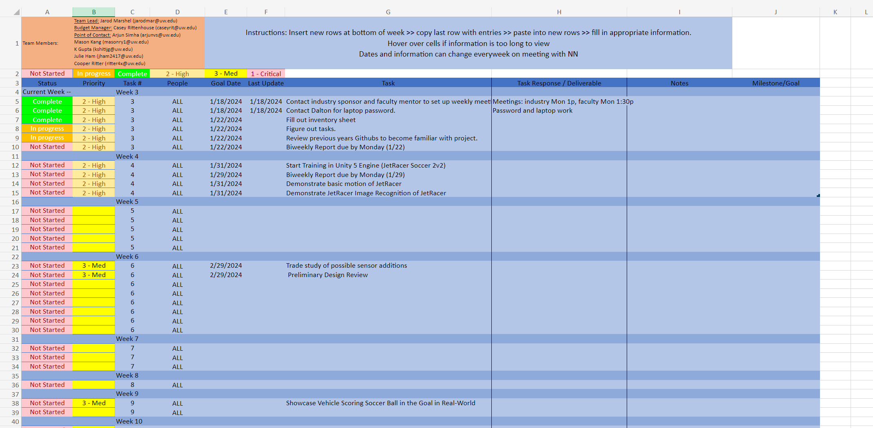
Detail
Kanban for task planning and timelines (will continue to update)

Slide 4
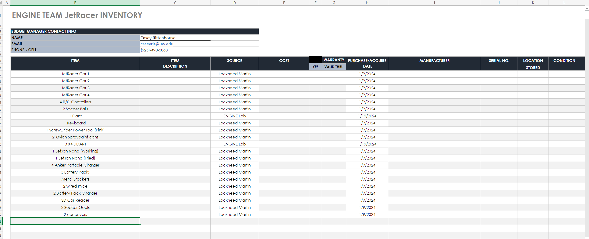
Detail
Current inventory spreadsheet with source of each item

Slide 5
Team Roles
Project Manager - Jarod
Point of Contact - Arjun
Budget Manager - Casey
ROS/Hardware (Layout, PCB, CAD, LIDAR):
Cooper, Casey, Jarod
Unity Team:
Mason
CV/Image Recognition Team:
K, Julie, Arjun

Slide 6
Previous Year's Work
Built and gained full range of motion of 4 JetRacers using software
Set up a simulation environment to virtually train the agents
Structured a reward system for the reinforcement learning model
Implemented object detection model that identifies a soccer ball, opponent, and goal
Implemented software to follow and strike a ball
Developed logic process for striking a ball into a goal
Simulation results with reward structure demonstrate that agents can be trained to efficiently compete in a 2v2 soccer match
Created a GitHub page documenting the hardware and software instructions to setup JetRacers, a summary of the work completed, and plans for future work

Slide 7
Our Final Deliverables
Demonstrate basic motion of JetRacer: 01/2024
Demonstrate JetRacer Image Recognition for soccer play: 01/2024
Trade study of possible sensor additions: 02/2024
Preliminary Design Review: 02/2024
Showcase vehicle scoring soccer ball in the goal in real-world: 03/2024
Add additional agents in the real world: 04/2024
Final Data Review: 05/2024

